Slide 1

House Purchase
Applied Data Science Capstone Project
IBM Data Science Professional Certificate Specialization
Akshay Bhaskaran
https://github.com/akshaybhaskaran

Slide 2
Introduction
This is the final capstone project of my IBM Data Science Certified Professional offered by Coursera
This project will focus on exploratory and statistical analysis of three different cities, and provides a recommendation for a user who is willing to purchase a new house in any of the three cities – Austin, Round Rock, Cedar Park.
Also, after finalizing a specific city, this project aims at suggesting zip codes based on the budget of the end-user with the help of some clustering algorithms

Slide 3
Data
One main data that is used to solve this problem is the location data that is freely offered by FourSquare.
Other important data that was used in this project are the latitude and longitude values of each cities, data related to Austin and its neighboring cities, average price of a house in the last year, current year, and next year projection, and some zipcode specific data to get deeper insights into Austin’s various zip codes
These were the data sources that were used to collect the above-mentioned data:
FourSquare Developer APIs
Austin, TX – Wikipedia
OpenCageData
Zillow
Austin Zip Maps
Python uszipcode library

Slide 4
Methodology
This picture shows the high-level methodology involved in approaching this project:
Exploratory Analysis of 5 categories
Clustering analysis on specific City
Plotting the results in a map
The upcoming slides will talk more in details about each of the steps involved

Slide 5
Exploratory Analysis
To perform this analysis on the three cities, there were 5 categories chosen which are:
Health
Education
Food
Entertainment
Average House Price History
For each category, a list of different venues were collected, and their overall aggregate was plotted for the three cities for better comparison (which is in the next slide)

Slide 6
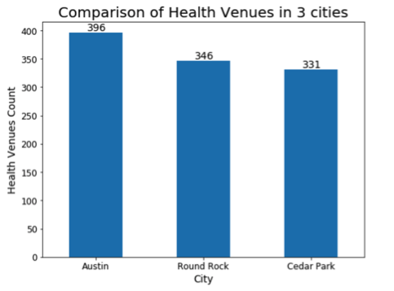
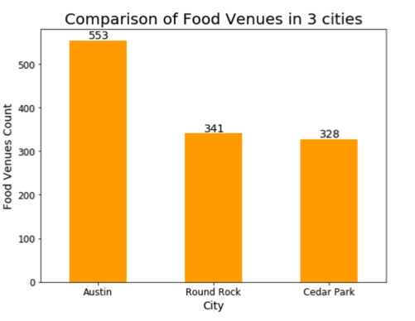
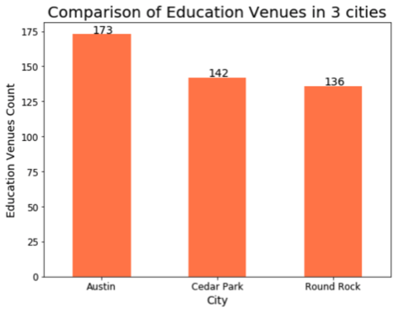
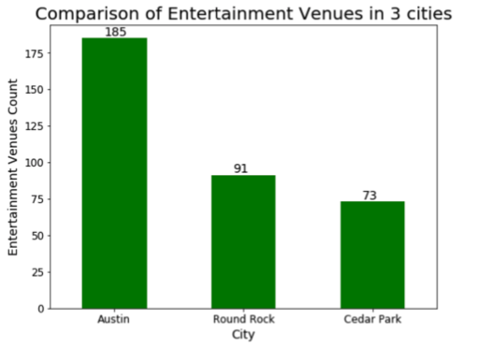
Exploratory Analysis (contd.)

Slide 7
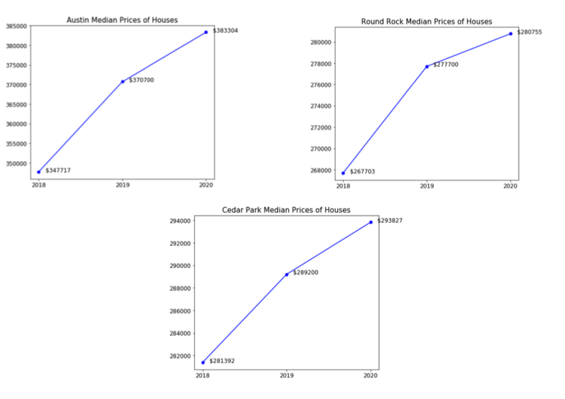
Exploratory Analysis (contd.)

Slide 8
Exploratory Analysis - Result
After performing the exploratory analysis, it can be observed that Austin, TX stands top compared to the other two cities in the list (Round Rock, Cedar Park)
So, we can fix out city to Austin, TX and remove the other two from the list
But, it is not just enough to finalize a city, we have to perform some learning and analysis in this city to see potential areas to purchase a house

Slide 9
Austin - Data Collection
After finalizing Austin as the city to perform our analysis on, we collect some additional data about this city
We have collected all the zip codes in Austin, and used python’s “uszipcode” library to get a deep insight into each zip code
Each zip code value returns the following values (that will further aid our analysis):
area code list
common city list
county
housing units
median house price
occupied housing units
population
…and more.

Slide 10
Clustering
After building a data frame that has columns filled with values of previously mentioned fields for each zip code, we perform some Clustering analysis on this data.
Keeping the cluster_size = 4, and running the iteration for around 400 times, our complete dataset gets split into 4 clusters
As a next step, I analyzed each cluster’s data by sorting the median_home_price column in ascending order, and the results are formulated in the next slide.

Slide 11
Results
From our clustering, it is observed that the complete data frame had split into 4 clusters, and each of this cluster had the median_house_price column clearly separated into bucket values (from a minimum to maximum range).
And for each of this cluster’s bucket values, I’ve given a budget range category based on the minimum and maximum amount, and these values are plotted in the Austin map
Cluster # | Median House price (Minimum range) | Median House price (Maximum range) | Budget
0 | $156,900 | $259,400 | LOW
1 | $460,200 | $641,200 | HIGH
2 | $279,200 | $442,300 | MEDIUM
3 | $72,100 | $163,900 | VERY LOW

Slide 12
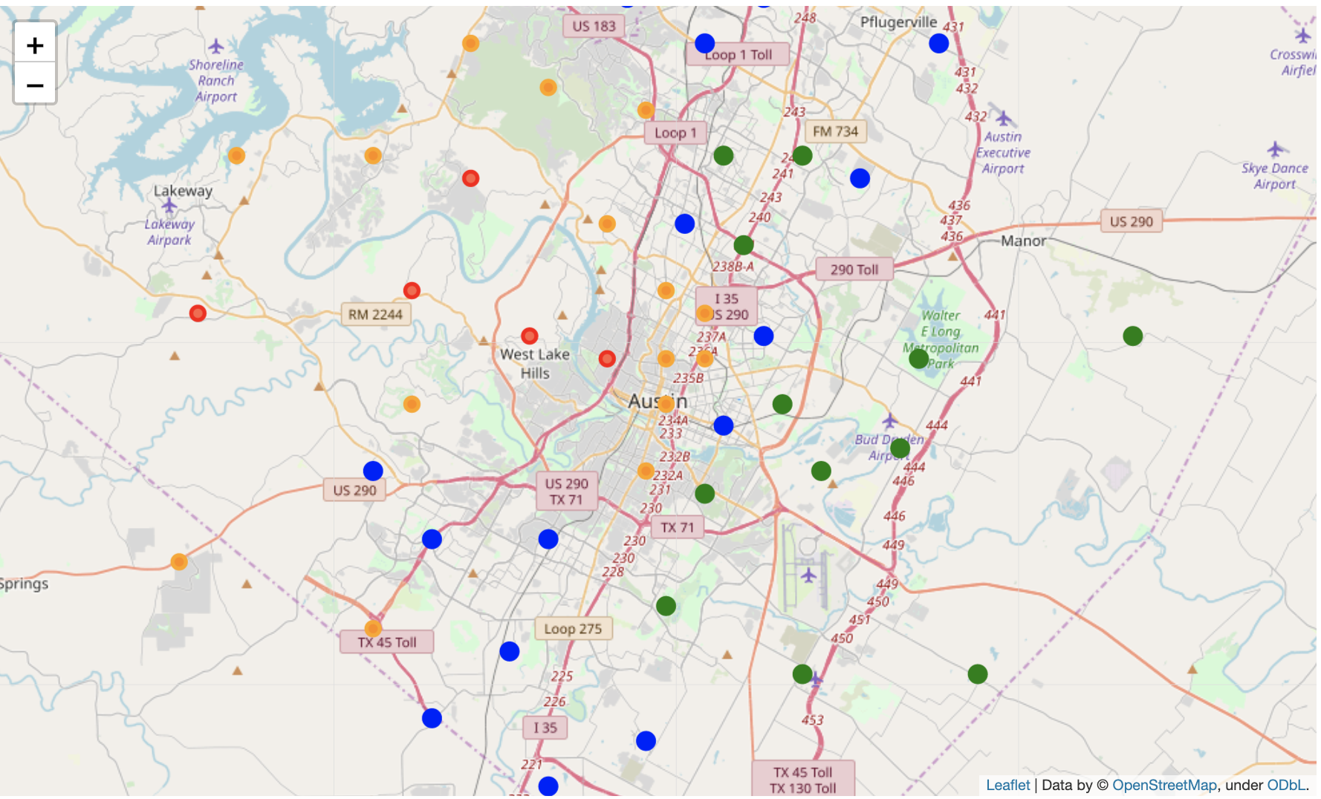
Results
Very low
Low
Medium
High

Slide 13
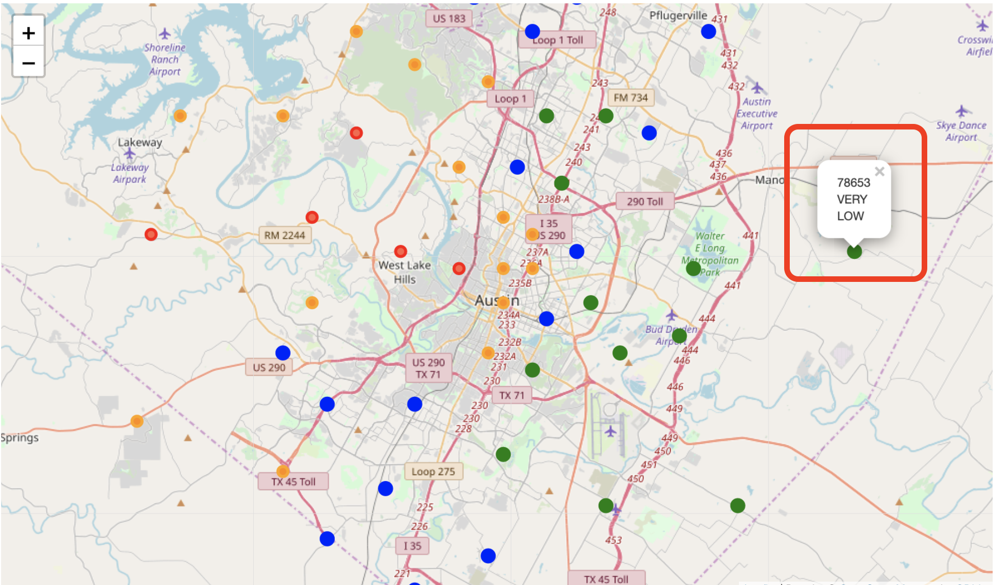
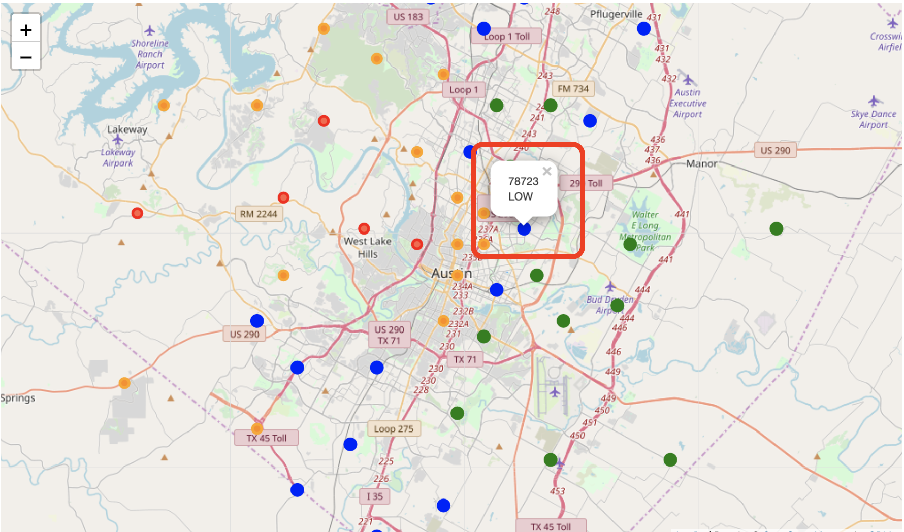
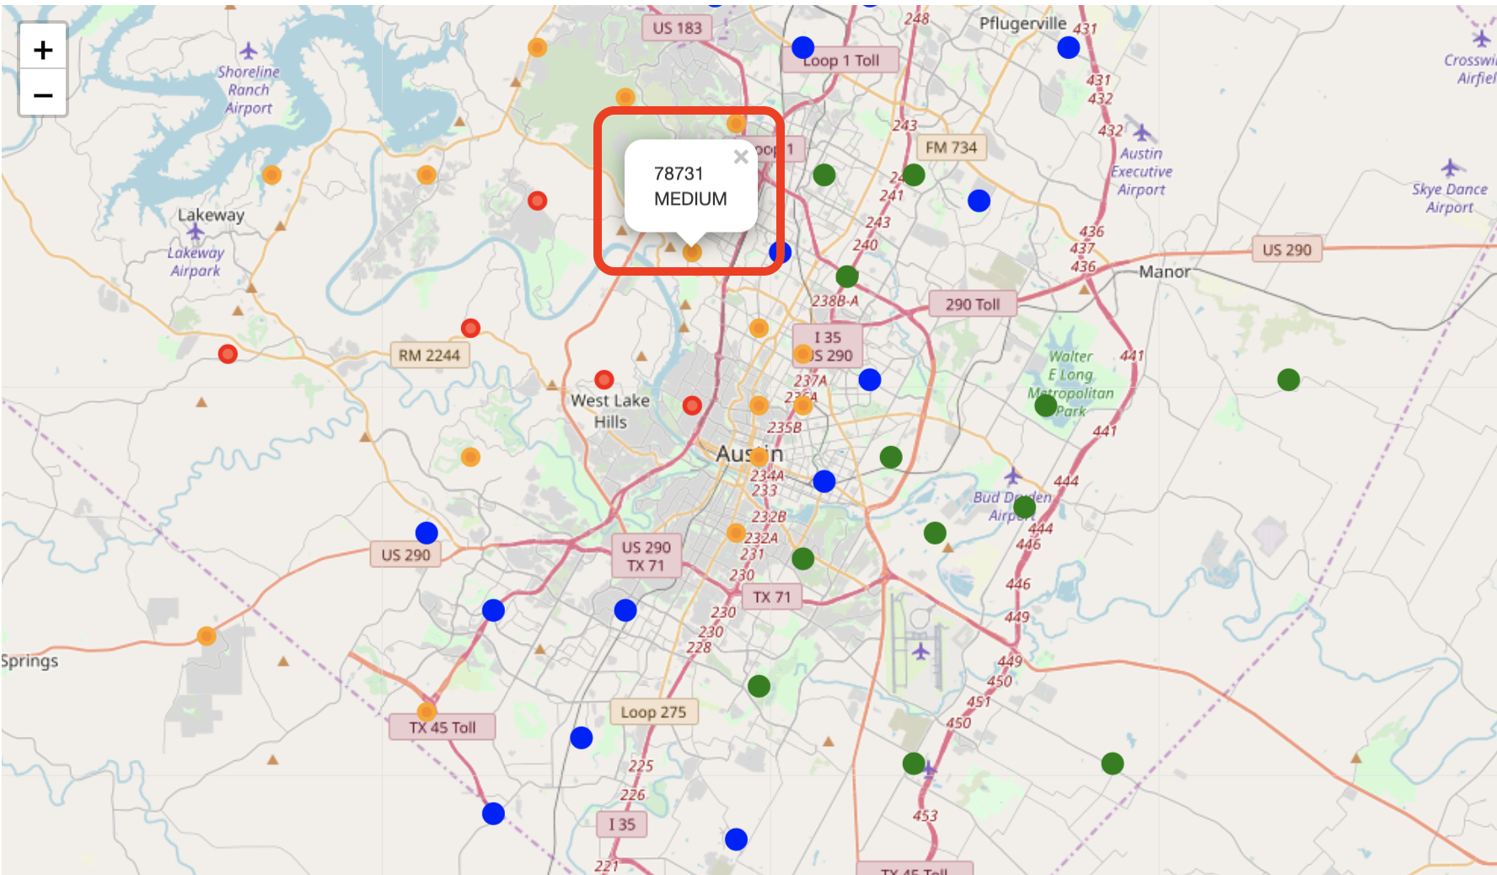
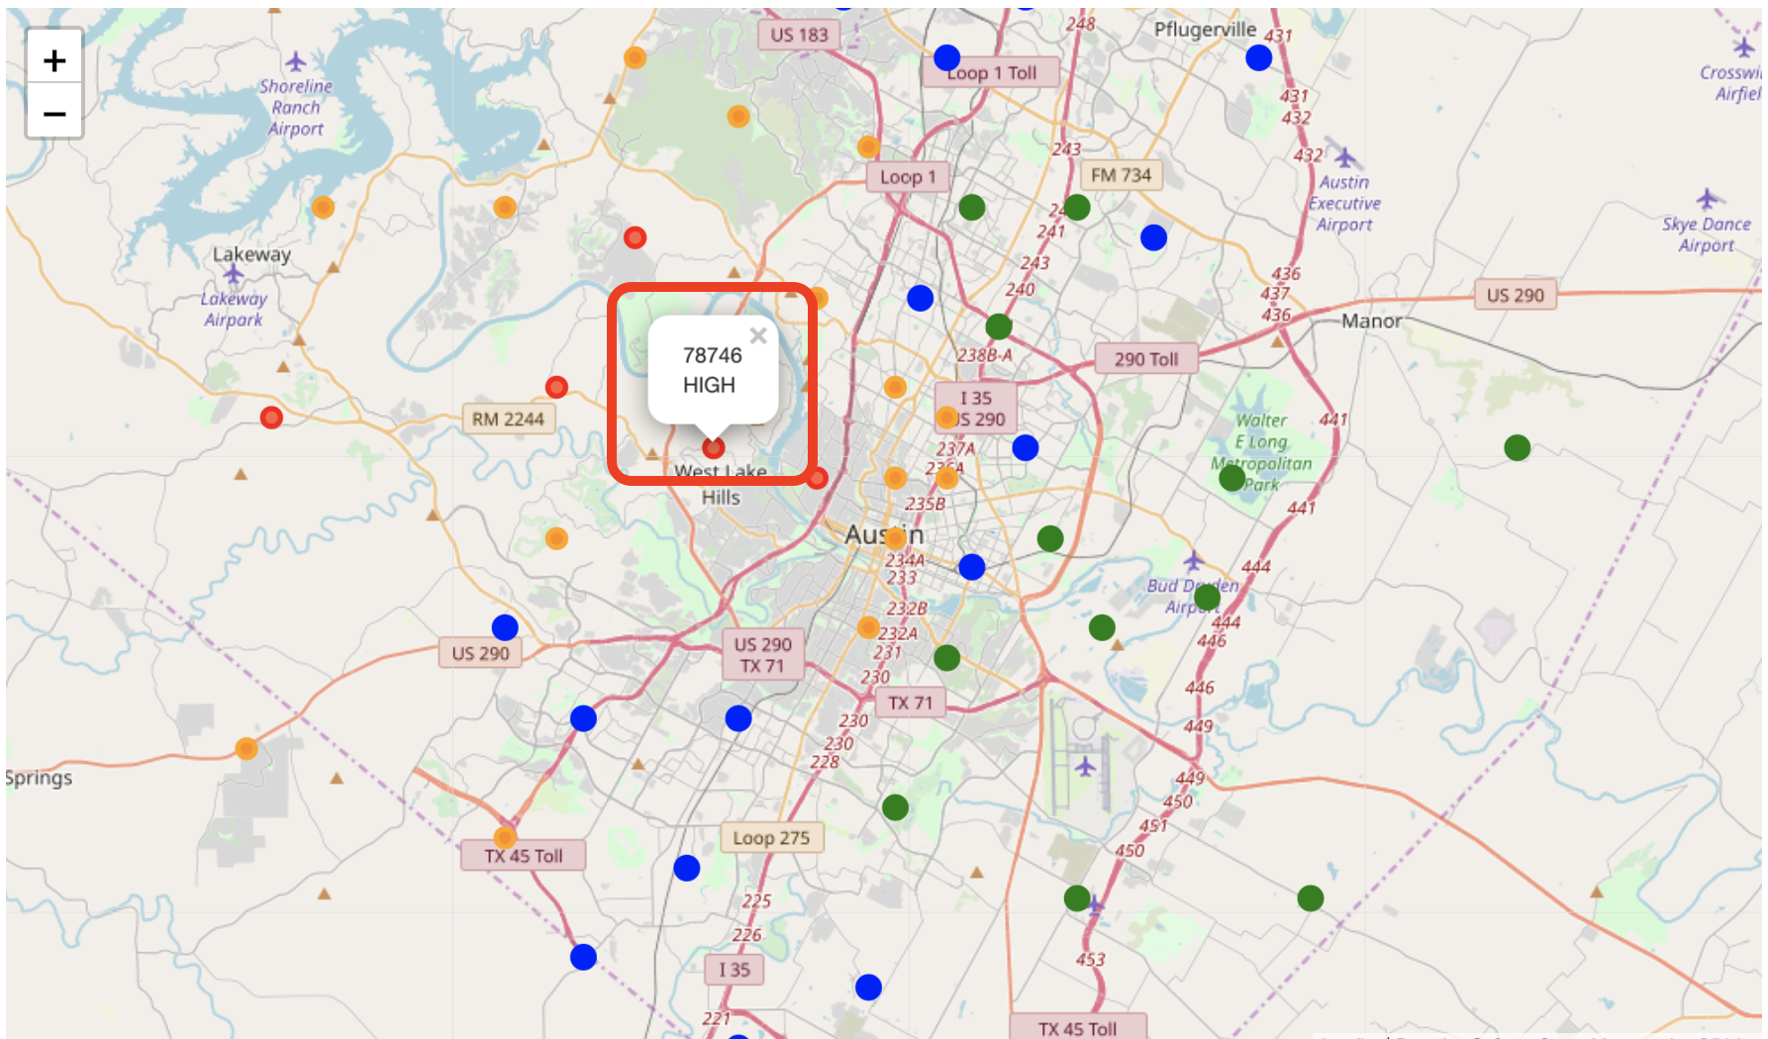
Results (contd.)

Slide 14
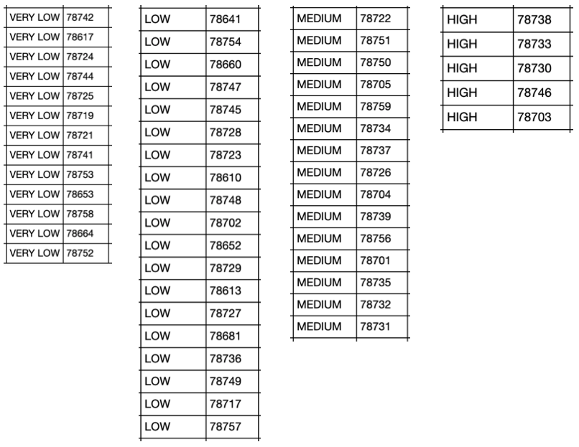
Conclusion
As a conclusion, these are the respective zip codes to purchase a house in Austin, if you have the category of budget available with you

